Slide 1
Climatic requirements for vegetable crops.
Vegetables are highly sensitive to climate because most of them have soft tissues, shallow root systems, and short growing periods.
Good climate conditions improve germination, vegetative growth, flowering, fruit set, yield, quality, shelf life, and resistance to pests and diseases.
Poor climate conditions can reduce crop establishment, delay maturity, cause flower abortion, encourage diseases, and lower market quality.

Slide 2
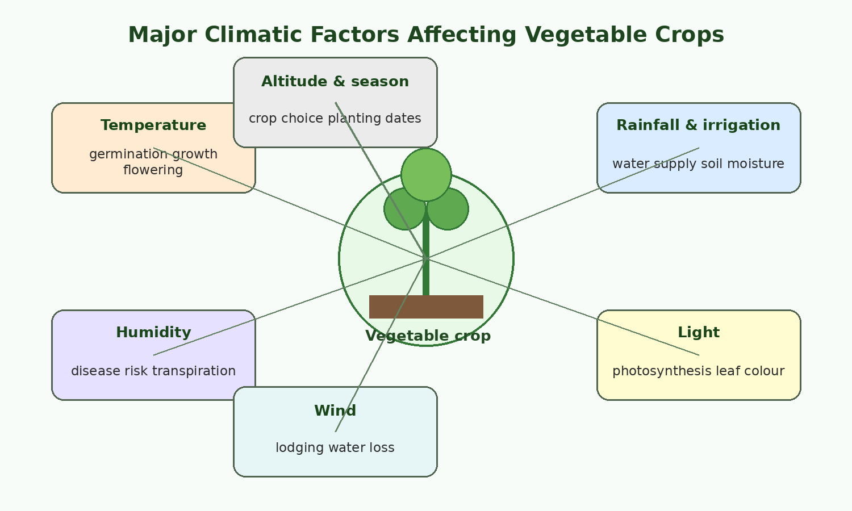
Meaning of Climatic Requirements
Climatic requirements refer to the weather and environmental conditions needed by a crop to grow, develop, and produce good yield. For vegetable crops, the most important climatic factors are temperature, rainfall, soil moisture, relative humidity, light, wind, altitude, and seasonal conditions.

Slide 3
Climatic factor | Why it is important in vegetables
Temperature | Controls seed germination, growth rate, flowering, fruiting, maturity, and crop quality.
Rainfall and irrigation | Supplies water for growth, nutrient movement, photosynthesis, and cooling of plant tissues.
Relative humidity | Affects transpiration, pollination, disease development, and freshness of leafy vegetables.
Light | Needed for photosynthesis and influences flowering, leaf size, colour, and dry matter accumulation.
Wind | Affects water loss, lodging, pollination, physical damage, and spread of pests and diseases.
Altitude | Influences temperature and season length; high altitude areas are generally cooler.
Season | Determines whether cool-season or warm-season vegetables can be grown successfully.

Slide 4
Temperature Requirements
Temperature is one of the most important climatic factors in vegetable production. Each vegetable has a minimum, optimum, and maximum temperature for growth. Below the minimum temperature, growth is very slow or stops. At the optimum temperature, growth is best. Above the maximum temperature, plants become stressed and may die.
Optimum Temperature: Each vegetable crop has a range of temperatures that are optimal for growth. For instance, cool-season vegetables like broccoli, cabbage, and spinach thrive in temperatures below 70°F (21°C), while warm-season crops such as tomatoes, peppers, and cucumbers prefer temperatures above 70°F.
Frost Sensitivity: Some crops are more tolerant of cold temperatures (e.g., cabbage can withstand light frosts), while others are very sensitive and should be planted only after the last frost.

Slide 5
Temperature groups of vegetable crops
Group | Preferred temperature range | Examples | Main notes
Cool-season vegetables | About 10-24°C | Cabbage, rape, lettuce, onion, carrot, beetroot, broccoli, cauliflower, peas | Grow best in cool conditions. High temperature may cause poor head formation, bolting, bitterness, and low quality.
Warm-season vegetables | About 18-30°C | Tomato, eggplant, pepper, cucumber, pumpkin, squash, okra, beans, sweet corn | Require warm conditions and are damaged by frost. Very high temperature can reduce flowering and fruit set.
Hot-season/tropical vegetables | About 25-35°C | Okra, amaranthus, pumpkin leaves, cowpea leaves, sweet potato leaves | Tolerate heat better than temperate vegetables, but still need enough moisture.

Slide 6
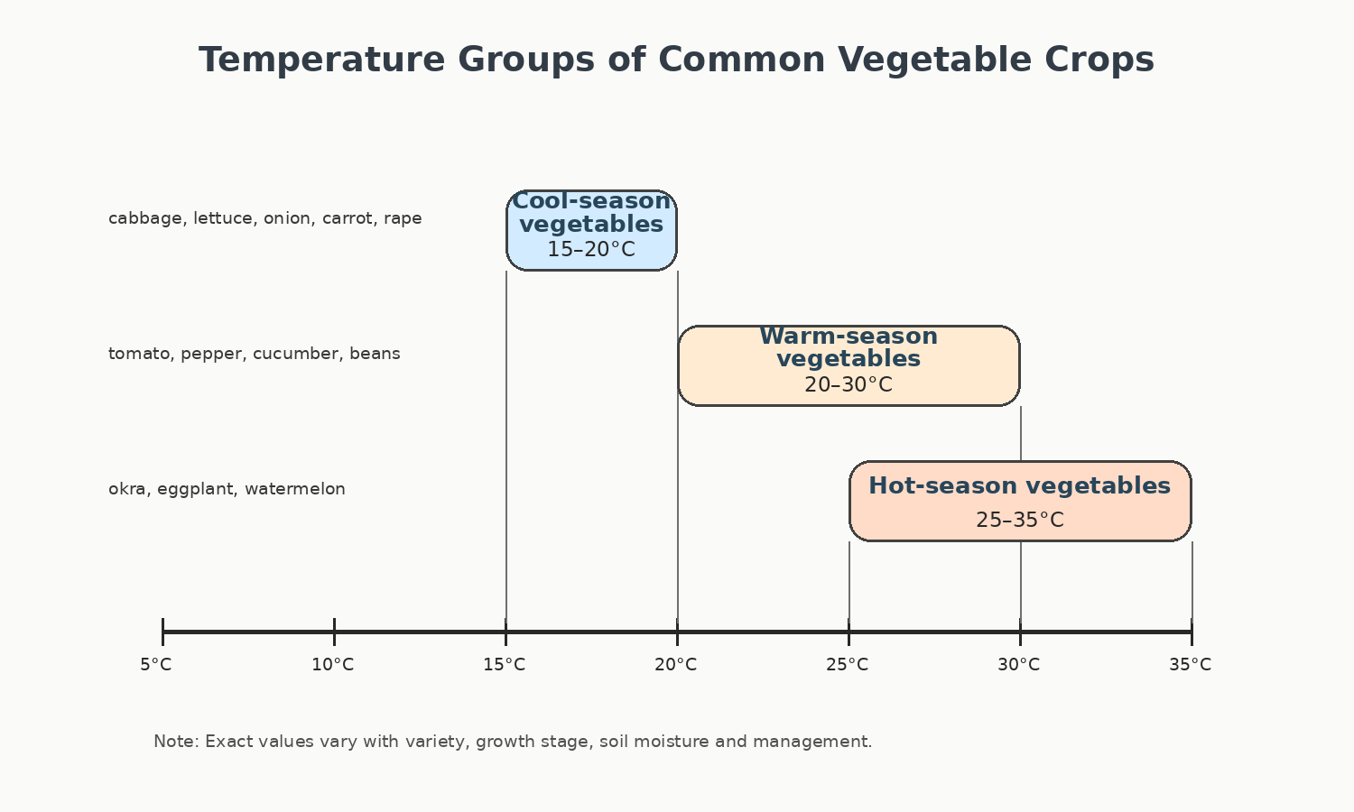

Slide 7
Effects of very low temperature
Poor or slow seed germination, especially in warm-season crops such as tomato, pepper, cucumber, okra, and beans.
Frost injury, which causes water in plant tissues to freeze and damage cells.
Purple colouration or stunted growth in some crops due to poor nutrient uptake.
Delayed maturity and poor market timing.
Flower and fruit damage in sensitive crops.

Slide 8
Effects of very high temperature
Excessive transpiration and wilting, especially when soil moisture is low.
Poor pollination and flower drop in tomatoes, peppers, beans, and cucurbits.
Sunscald on fruits such as tomatoes and peppers.
Bitter taste and early bolting in lettuce and other leafy vegetables.
Poor curd or head formation in cauliflower, cabbage, and broccoli.
Fast maturity but reduced size and poor quality.

Slide 9
Rainfall and Water Requirements
Crop type | Water requirement | Important stages when water is critical
Leafy vegetables | High and frequent moisture requirement | Germination, leaf expansion, and harvesting period.
Fruit vegetables | Moderate to high water requirement | Flowering, fruit set, and fruit enlargement.
Root vegetables | Moderate and uniform moisture requirement | Root initiation and root enlargement.
Bulb vegetables | Moderate moisture requirement | Bulb formation; excess water near maturity should be avoided.

Slide 10
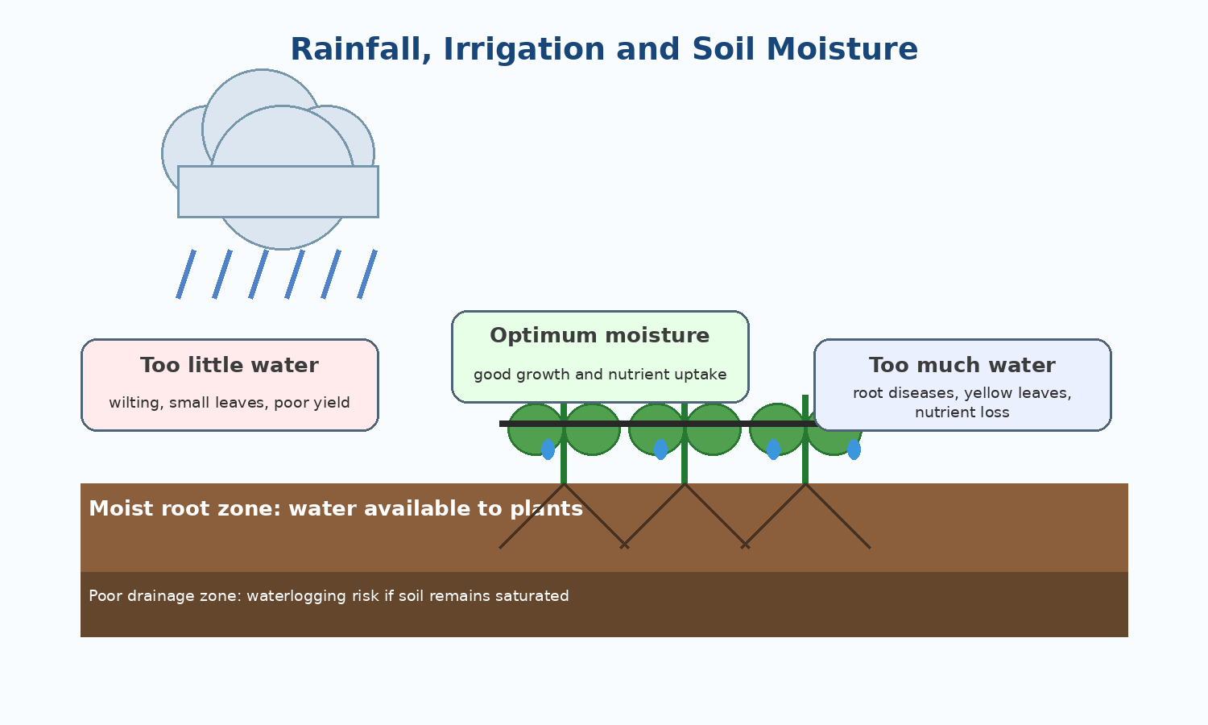

Slide 11
Crop Water Requirement Calculations
Crop water requirement is the amount of water needed by a crop for normal growth, development, and yield. It is mainly influenced by climate, crop type, crop growth stage, soil conditions, and irrigation efficiency.
ETc = ETo × Kc
Symbol | Meaning
ETc | Crop evapotranspiration or crop water requirement
ETo | Reference evapotranspiration
Kc | Crop coefficient

Slide 12
Reference Evapotranspiration (ETo)
Reference evapotranspiration (ETo) is the amount of water lost from a reference grass surface through evaporation and transpiration. It represents the evaporative demand of the atmosphere.
Air temperature
Solar radiation or sunshine hours
Wind speed
Relative humidity
Season and location
Example: If ETo = 5.0 mm/day, the atmosphere can remove about 5 mm of water per day from a reference crop surface.

Slide 13
Crop Coefficient (Kc)
The crop coefficient (Kc) adjusts ETo according to crop type and growth stage. Young crops have low Kc values, while crops at full canopy normally have higher Kc values.
ETc = ETo × Kc
Growth stage | Description |  | Typical Kc behaviour
Initial stage | Germination and early growth |  | Low
Crop development stage | Rapid vegetative growth |  | Increasing
Mid-season stage | Full canopy, flowering, and fruiting |  | Highest
Late season stage | Maturity and harvesting |  | Declining
Crop | Initial Kc | Mid-season Kc | Late-season Kc
Tomato | 0.60 | 1.15 | 0.80
Cabbage | 0.70 | 1.05 | 0.95
Onion | 0.70 | 1.05 | 0.75
Maize | 0.30–0.40 | 1.15–1.20 | 0.60
Beans | 0.35–0.50 | 1.05–1.15 | 0.70–0.90

Slide 14
Problem: A cabbage crop has a reference evapotranspiration (ETo) of 4.8 mm/day. The crop coefficient (Kc) at mid-season is 1.05. Calculate: (a) daily ETc, (b) weekly ETc, and (c) the weekly water volume for a 0.25 ha field.

Slide 15
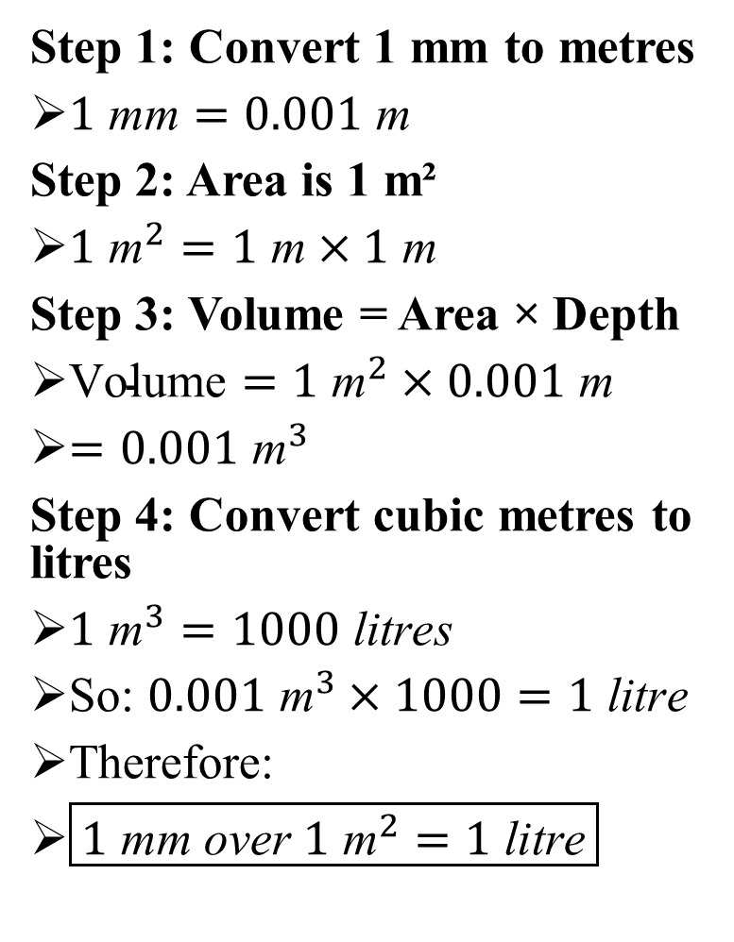
Step 1: Convert 1 mm to metres
$1 \text{mm}=0.001 \text{m}$
Step 2: Area is 1 m²
$1{ \text{m}}^{2}=1 \text{m}×1 \text{m}$
Step 3: Volume = Area × Depth
$\text{Volume}=1{ \text{m}}^{2}×0.001 \text{m}$
$=0.001{ \text{m}}^{3}$
Step 4: Convert cubic metres to litres
$1{ \text{m}}^{3}=1000 \text{litres}$
So: $0.001{ \text{m}}^{3}×1000=1 \text{litre}$
Therefore:
$\boxed{1 \text{mm} \text{over} 1{ \text{m}}^{2}=1 \text{litre}}$

Slide 16
Relative Humidity Requirements
Relative humidity is the amount of water vapour in the air. It influences transpiration, disease development, pollination, and the freshness of harvested vegetables. Most vegetables grow well under moderate relative humidity.
Humidity condition | Effect on vegetable crops
Low humidity | Increases transpiration and may cause wilting, flower drop, and poor fruit set. Leafy vegetables lose freshness quickly.
Moderate humidity | Generally favourable for growth, pollination, and normal transpiration.
Very high humidity | Encourages fungal and bacterial diseases such as blights, mildews, rots, and leaf spots. It can also reduce pollination in some crops.

Slide 17
Altitude and Season
Altitude affects vegetable production mainly through its effect on temperature. High-altitude areas are generally cooler and may be suitable for cool-season vegetables. Low-altitude areas are usually warmer and are better for warm-season and tropical vegetables.
Area/season condition | Suitable vegetable examples
Cool highland areas | Cabbage, lettuce, broccoli, cauliflower, peas, carrots, beetroot, onion.
Warm lowland areas | Tomato, pepper, eggplant, okra, cucurbits, beans, sweet corn.
Rainy season | Leafy vegetables and many warm-season crops, but disease and waterlogging management are important.
Dry season with irrigation | Often best for high-quality vegetable production because disease pressure may be lower and water can be controlled.

